Slide 1
How work flows
Uladzimir Abramchuk

Slide 2

Uladzimir Abramchuk
10+ years of programming
4+ years of management
General MBA
SAFe SPC
Coach ICF
Email: u.abramchuk@gmail.com
LinkedIn: uabramchuk
Instagram: man.in.the.middle.by

Slide 3
Flow

Slide 4
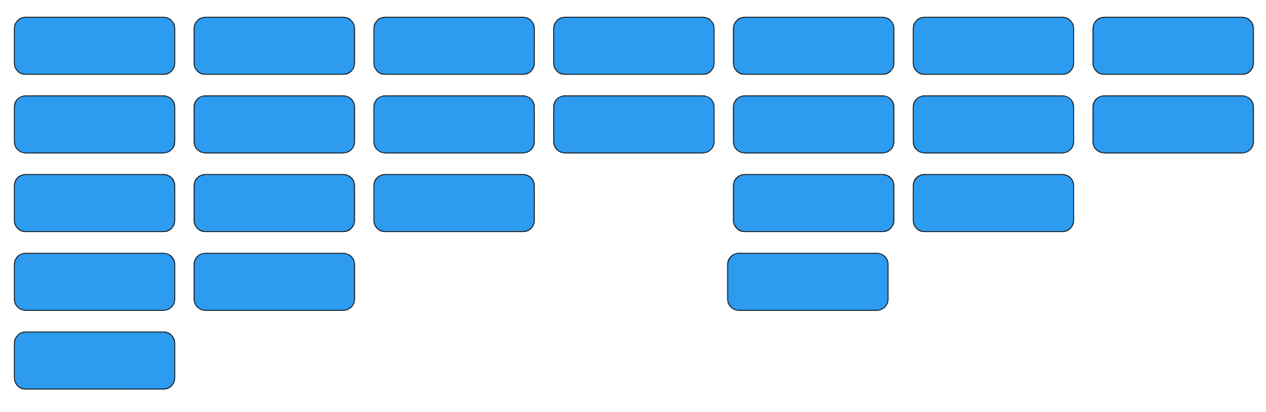
Flow
Notes:
What percentage of time your work spends just waiting, doing nothing
Influenced by:
Queues
Waiting for feedback
Batch sizes

Slide 5
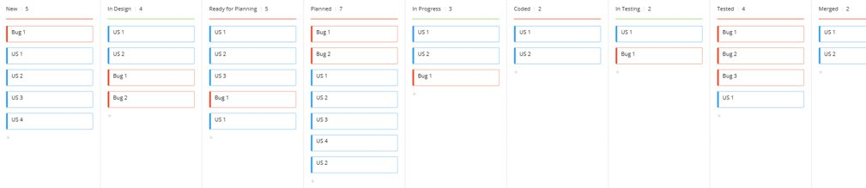
Flow in More Details
Notes:
What percentage of time your work spends just waiting, doing nothing
Influenced by:
Queues
Waiting for feedback
Batch sizes

Slide 6
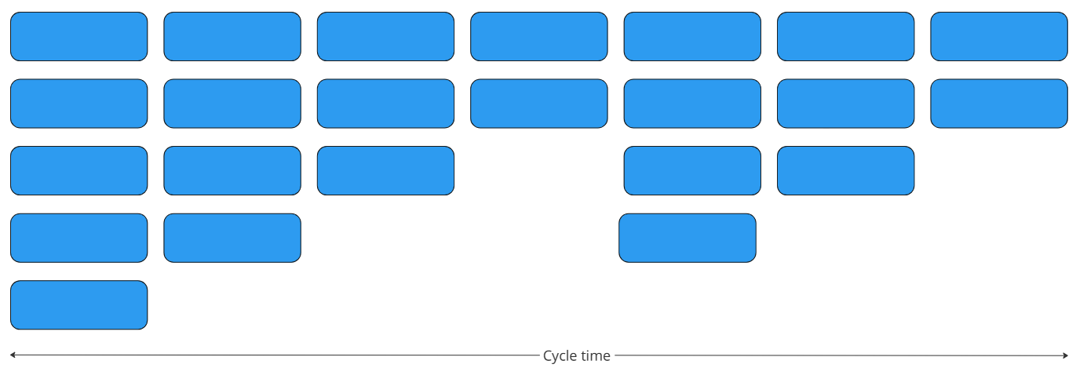
Cycle Time
Notes:
What percentage of time your work spends just waiting, doing nothing
Influenced by:
Queues
Waiting for feedback
Batch sizes

Slide 7
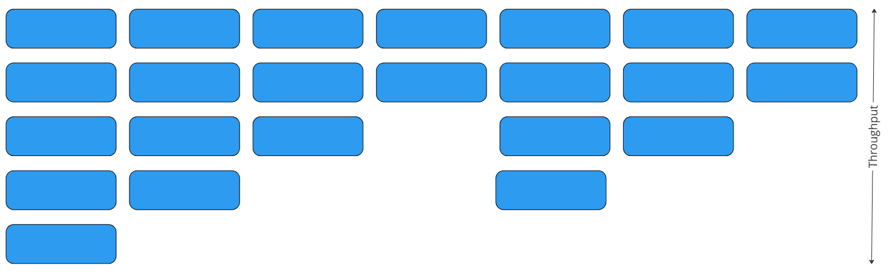
Throughput
Notes:
What percentage of time your work spends just waiting, doing nothing
Influenced by:
Rework
Bottlenecks
High capacity load

Slide 8
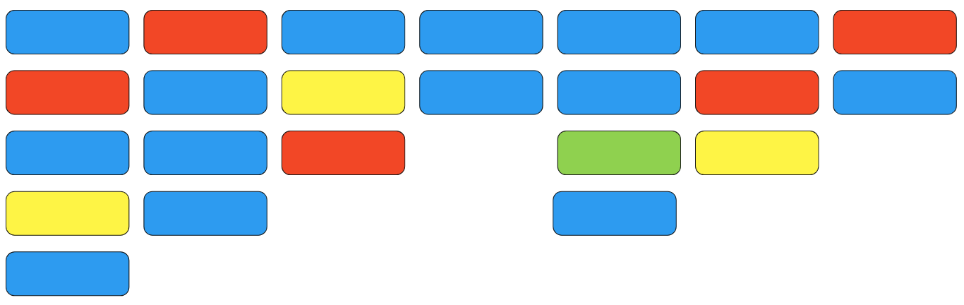
Distribution

Slide 9
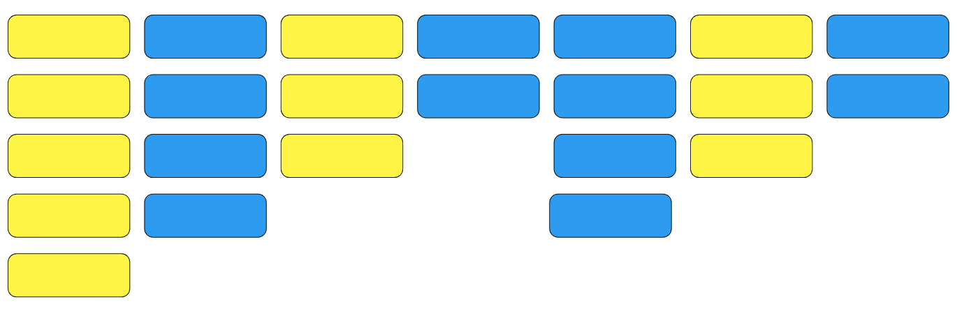
Efficiency
Efficiency = Active State Time / Cycle Time
Notes:
What percentage of time your work spends just waiting, doing nothing
Influenced by:
Queues
Waiting for feedback, approvals
Batch sizes

Slide 10
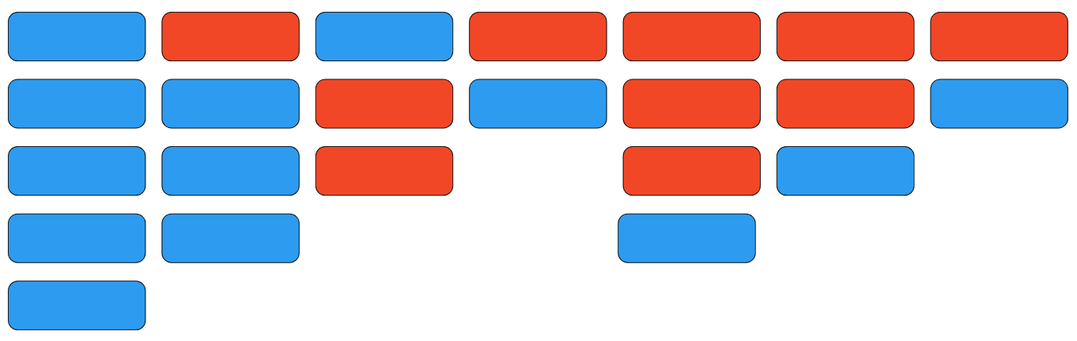
Quality
%C&A = (# Complete & Accurate / Total) * 100

Slide 11
What's under the hood?

Slide 12
Queues
Product development inventory is physically and financially invisible
Queues are the root cause of the majority of economic waste in product development
Queues are caused by variability (linearly) and high capacity utilization (exponentially)

Slide 13
The Effect of Queues
Longer cycle time
Increased risk
More variability
More overhead
Lower quality
Delayed feedback
Less motivation
Notes:
It's not manufacturing, to product something new we have to do something new and face uncertainty.
Variability can create economic value. Look at payoff function and analyze.
It's a U-curve optimization.
Think about cost of variability, not only minimization of it.
There is good variability and a bad one.

Slide 14
Variability
Variability refers to the natural differences that exist in a process or system
Examples: Work items arrival rate, Processing time of work items, Resulting code quality
Notes:
It's not manufacturing, to product something new we have to do something new and face uncertainty.
Variability can create economic value. Look at payoff function and analyze.
It's a U-curve optimization.
Think about cost of variability, not only minimization of it.
There is good variability and a bad one.

Slide 15
How to Minimize Variability
Operate in the linear range of system performance
Forecasting becomes exponentially easier at short time-horizons
Many small experiments produce less variation than one big one
Repetition and reuse reduce variation
Buffers trade money for variability reduction

Slide 16
How to Reduce Batch Size
Loose coupling between product subsystems enables small batches (system architecture)
Proximity enables small batches (communication)
Short run length reduce queues (timeboxing)
Good infrastructure enables small batches
Notes:
The entire batch is limited by its worst element
Economic batch size is a U-curve optimization
Batch size reduction saves much more than you think

Slide 17
Cadence
Use a regular cadence to limit the accumulation of variance
Use cadence to make waiting times predictable

Slide 18
WIP Constraints
Set upper limits on the amount of in-process inventory
Control cycle time and flow
Force rate-matching
Control number of projects in process

Slide 19
Reacting to Emergent Queues
Block all demand when WIP reaches its upper limit
When WIP is high purge low-value projects
Control WIP by shedding requirements
Pull high-powered experts to emerging bottlenecks
Develop people who are deep in one area and broad in many
Cross-train resources at adjacent processes
Use upstream mix changes to regulate queue size
Notes:
Watch the outliers
Create a preplanned escalation process for outliers
Increase throttling as you approach the queue limit
Differentiate quality of service by workstream
Adjust WIP constraints as capacity changes
Prevent uncontrolled expansion of work
Constrain WIP in the section of the system where the queue is most expensive
Small WIP reductions accumulate
Make WIP continuously visible

Slide 20
Bottlenecks
Reduce variability before a bottleneck (upstream)
Reduce batch size before you attack bottlenecks
Use global constraints for predictable and permanent bottlenecks
Develop and maintain alternate routes around bottlenecks

Slide 21
Quality
In a wide sense, it is about quality of product, processes, how well customer's needs satisfied, etc.
Reduce rework
Automation
Infrastructure quality

Slide 22
Fast Feedback
Enables smaller batches and vice versa
Makes learning faster and more efficient
Gives a sense of control

Slide 23
Communication
Choose the right amount of communication: more intense inside the team, less intense between teams.
Conway's law: organizations design systems that mirror their own communication structure
Enable horizontal communication between teams, departments. But don't overdo it.

Slide 24
Decentralization
Permits to adapt to uncertainty much faster
Reduces dependency on centralized control
Minimizes necessity to travel through the corporate hierarchy

Slide 25
Examples
DevOps and microservices
Scrum
Kanban
SAFe
...

Slide 26
Conclusions

Slide 27
Conclusions
The faster something is done, the earlier it brings money and/or feedback.
The flow should be fast, full-flown and even.
Optimize the flow as a whole. Local optimum usually doesn't coincide with the global one.
Visualize important stuff. If you don't see something, don't talk about it, it doesn't exist.

Slide 28
More Conclusions
Keep variability under control with WIP limits and cadence.
The fastest way to production is quality, not speed.
Optimize workflow through and around bottlenecks.
Get feedback as fast as possible.
Communication allows to fix and prevent a lot of delays.
Decentralization makes decision making faster.
Communication and decentralization help to overcome many limitations of hierarchical structures.

Slide 29
Q&A

Slide 30

Thank you!

